Slide 1
Painting a fuller picture
Data driven insights
for improving wellbeing via housing & energy
Prof. Harriet Thomson

Slide 2
Excessively cold homes during winter
Poor indoor air quality (humidity, drafts & mould)
Direct consequences of fuel poverty
Poor physical & mental health
Inadequately lit homes
Reduced household budgets
Non-payment of energy bills & debts
Supply and solvency issues for utilities
Indirect consequences of fuel poverty
Political & fiscal impacts
Air pollution (indoor & outdoor)
Improved comfort
Improved health & well-being
Social exclusion
Benefits of addressing fuel poverty
Reduced air pollution
Improved household, utility company & state budgets
Reduced political tensions
Summary diagram based on: Boardman, 2011; Bouzarovski, 2014; Buzar 2007; COMBI 2016; Healy 2003; Marmot Review Team 2011; Thomson and Snell, 2013; Pye et al, 2015; Snell, Lambie-Mumford, and Thomson, 2018.

Slide 3
Snapshot of the crisis
UK-wide Ipsos Mori poll
28th October - 2nd November 2022

Slide 4
Reduced energy services provision
65%
57%
48%
35%
[past 3 months]
Used less hot water for showers or baths
Ran washing machine on colder cycle
Reduced use of tumble dryer
Ate cold meals to avoid using energy

Slide 5
Riskier energy services reductions
44%
15%
14%
[past 3 months]
Cooked with alternative equipment (e.g. BBQ)
Reduced use of electrical medical equipment
Switched off fridge/freezer for part of the day

Slide 6
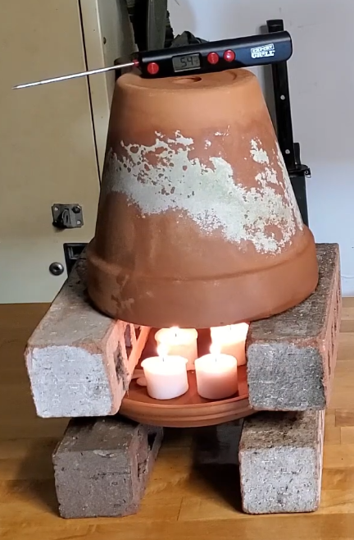
Dangerous energy service provisioning
28%
[past 3 months]
Used candles for lighting

Slide 7
Expected behaviours over winter (22/23)
40%
17%
15%
[next 3 months]
Turn heating off, even if the property is cold
Use a gas or electric oven for heating
Improvised fuels e.g., clothes, books, furniture

Slide 8
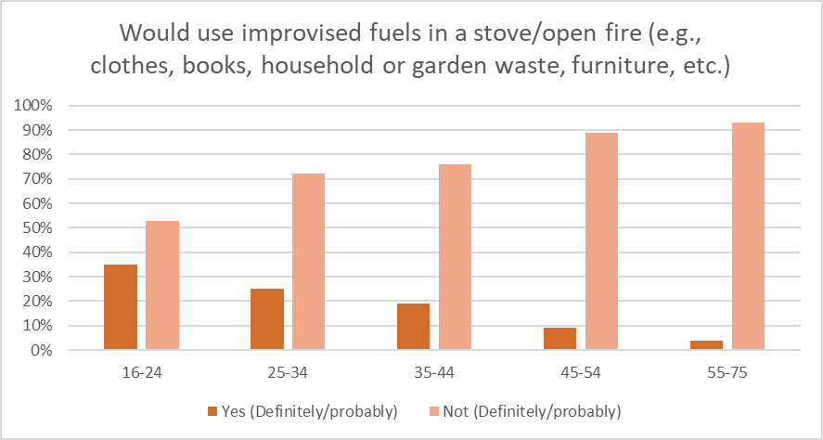
Some notable differences
in terms of age

Slide 9
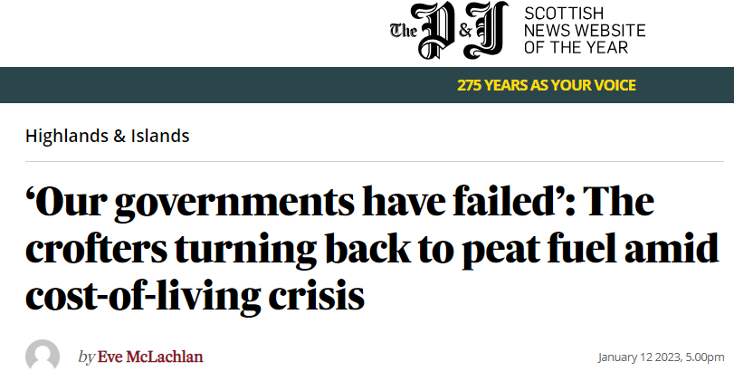
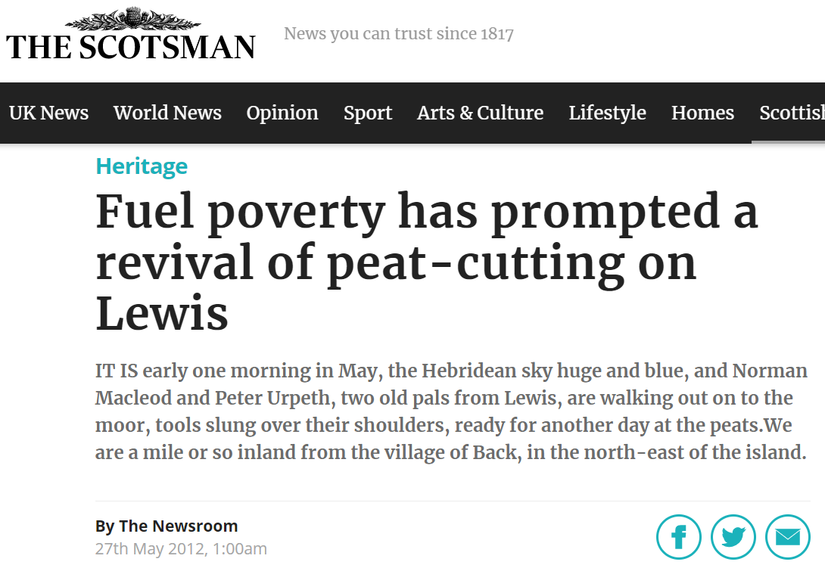

Slide 10
Implications for decarbonisation of housing

Slide 11
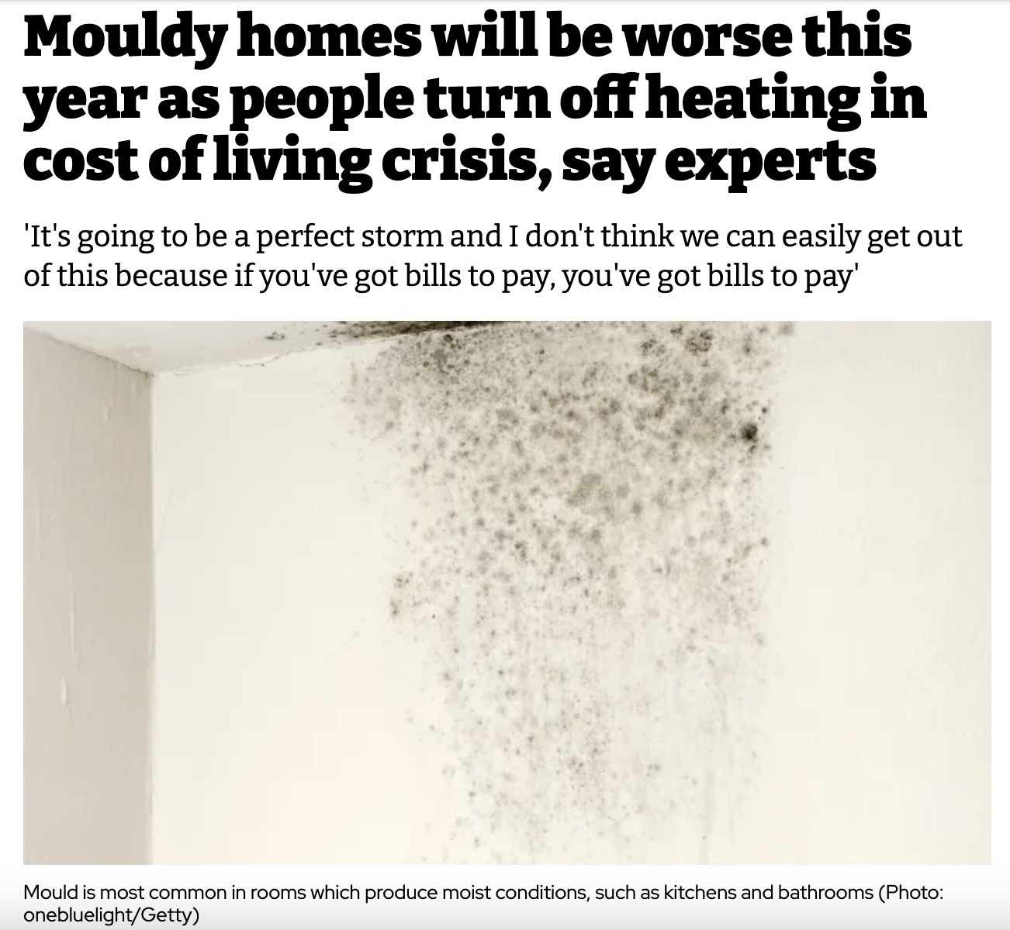
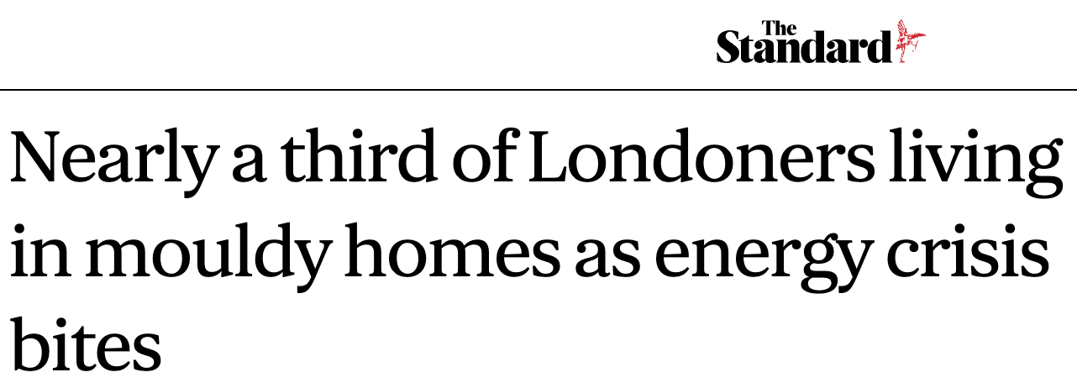
I. Housing stock quality has worsened
Under-heating
Widespread reduction in heating due to cost-of-living pressures
Increased heating costs
Reduced energy efficiency due to building fabric damage
Mould, damp, and rot
Increase in mould issues due to poor heating practices

Slide 12
II. Energy & building models are wrong(er)
Widespread shifts in energy use patterns
Return to burning biomass
(wood, peat, etc.)
No routine data collection on coping strategies
Living without energy is the new norm

Slide 13
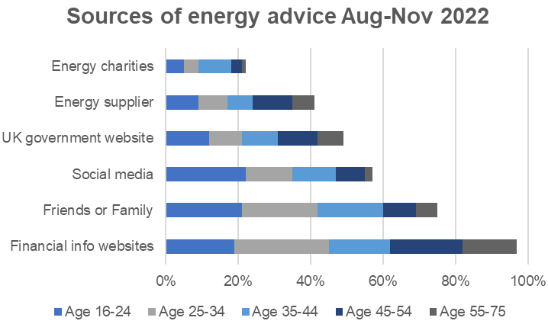
III. Energy misinformation is
widespread
We need deeper understanding of where people get energy advice from, given some worrying trends.

Slide 14
Key areas to address
Monitoring data
Financial support
Energy efficiency
Unable to capture live impacts
Insufficient coverage
Refurbishment rate too low

Slide 15
Community energy as the solution?

Slide 16
Strengths
Mobilise local knowledge
Place-sensitive approaches
Local action for local people
Trusted local organisations
Democratic principles

Slide 17
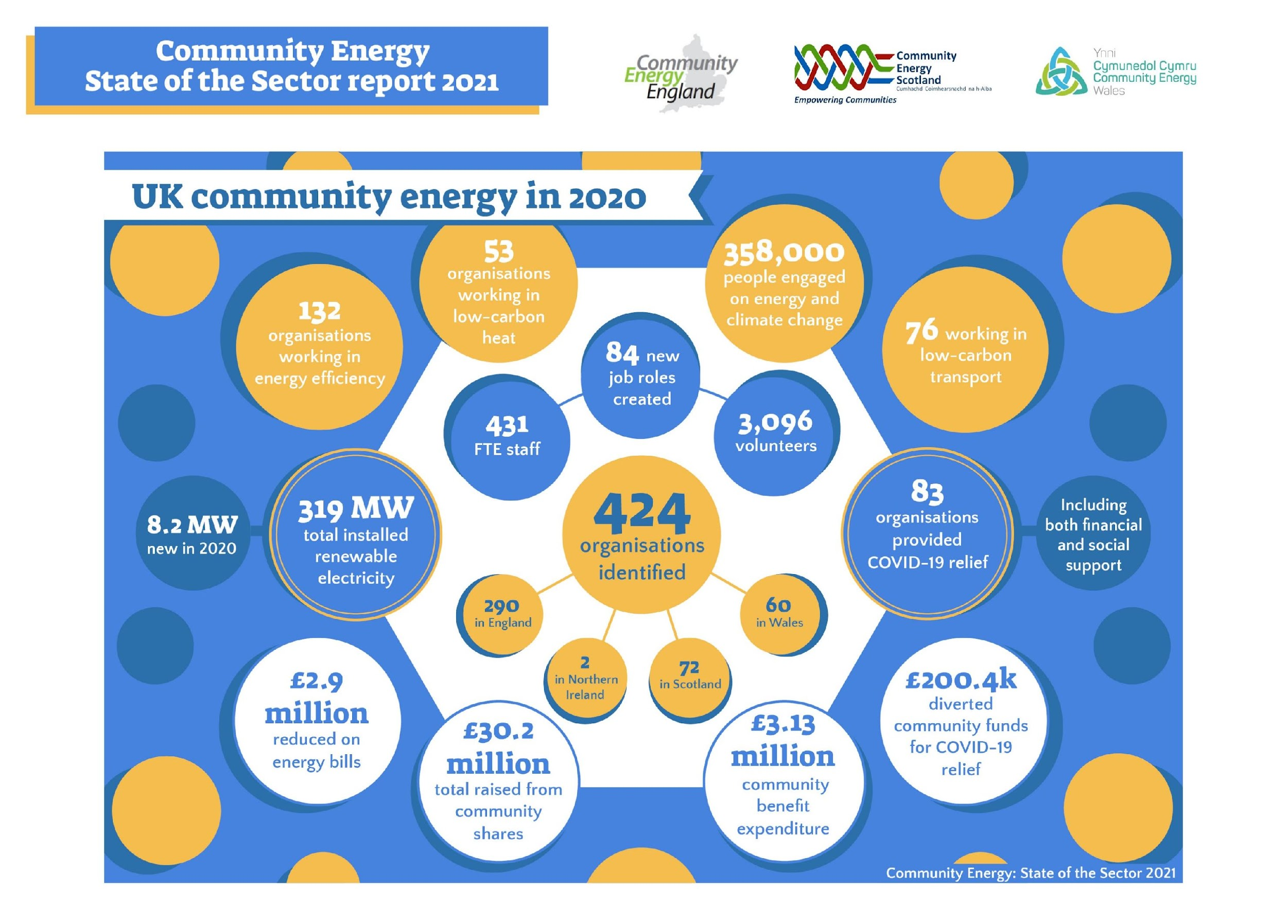
Community energy in the UK

Slide 18
Community energy in the UK
This is 0.04% of total UK capacity

Slide 19
Community energy in the UK
This is 0.02% of UK domestic electricity bills

Slide 20
Key barriers to community energy
Legislation
Funding
Knowledge
GDPR, gatekeepers
Short-term, competitive grants
Lack of expertise

Slide 21
www.energysolidarity.eu/solidarity-toolkit/

Slide 22
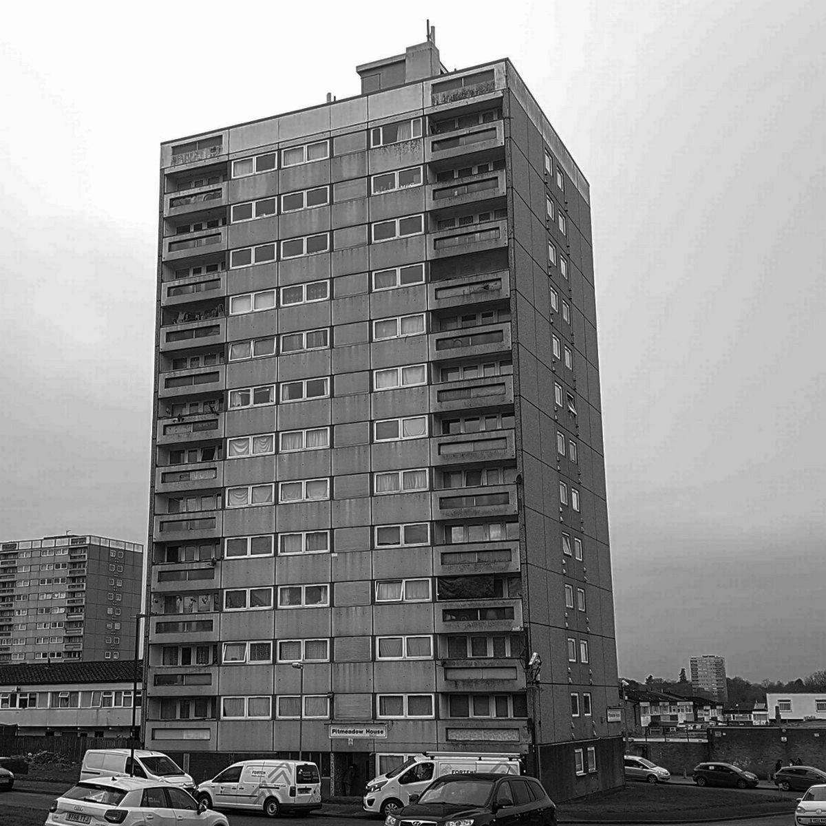
Thanks for
listening
harriet.thomson@glasgow.ac.uk
contactus-sustainableenergy@glasgow.ac.uk

