Slide 1
Making it right, making it fair for terminally ill people
EAS Conference, 15th November 2024
Ellie Wagstaff, Senior Policy Manager
Marie Curie Scotland

Slide 2
Agenda
Dying, death and bereavement in Scotland
Fuel poverty at the end of life
Making it right and making it fair for terminally ill people; what would success look like?

Slide 3
Definitions
Terminal illness; any condition which is likely to result in a person’s death
Palliative care; values-based care, promotes dignity, relieves suffering, demonstrates compassion, fights for justice
(Dr Mhoira Leng)
End of life care; is part of palliative care particularly for people thought to be in their last year of life

Slide 4
Dying, death, and bereavement in Scotland
More people will be dying at home in future
By 2040:
Up to 10,000 more people will need palliative support
Two thirds of all deaths will take place in people’s own homes, as well as care homes, and hospices
Multi-morbidities will have increased by over 80%
Over 85s will account for 45% of all deaths

Slide 5
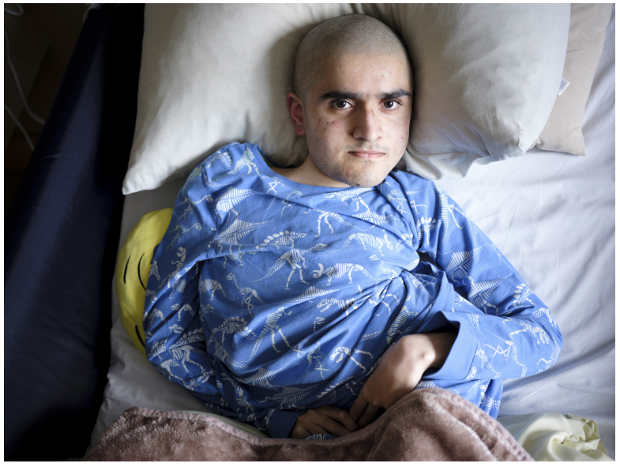
Amandeep, 22
Photo-credit: Margaret Mitchell for Dying in the Margins

Slide 6
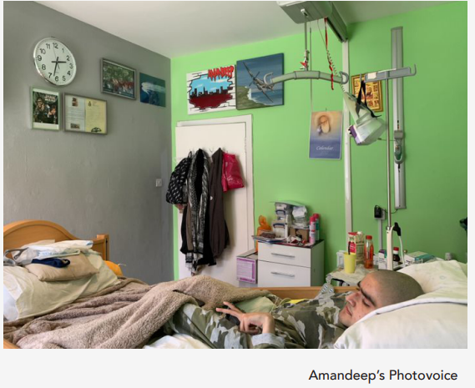
Amandeep, 22
“Do we heat our house up or do we eat food?
It’s very much getting to that point now.”
- Amandeep

Slide 7
Most prominent energy related costs for terminally ill people?
Heating
Medical equipment
Medicine storage
Hot water and utilities
Smart home technology/other independent living devices

Slide 8
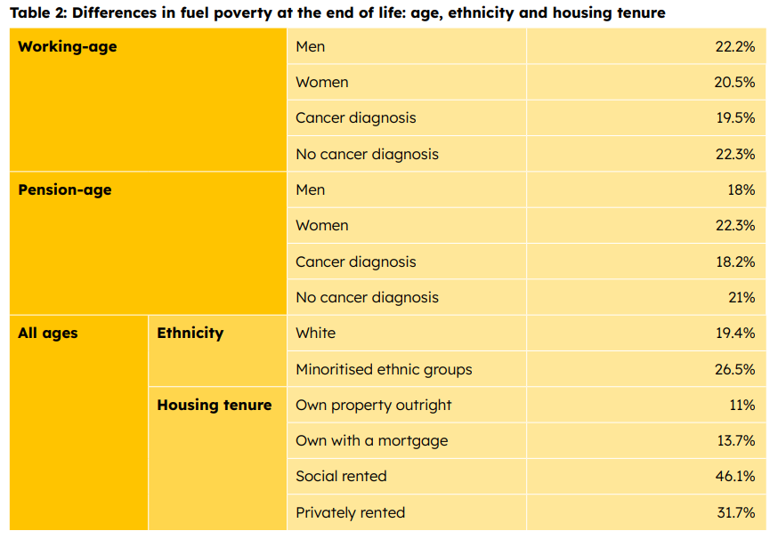
Fuel poverty at the end of life
1 in 5 people in Scotland experience fuel poverty at the end of life

Slide 9
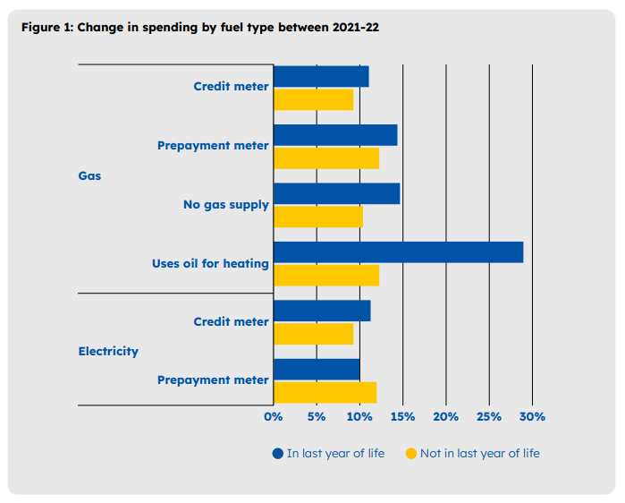
Fuel poverty at the end of life
1 in 5 people in Scotland experience fuel poverty at the end of life

Slide 10
Making it right and making it fair for terminally ill people; what would success look like?
Disaggregated end of life fuel poverty data to better understand local population need
Whole-system working
Trauma-informed independent advocacy
A Social Tariff with 50% reduction at market rate
Targeted social security
WHP
PAWHP
FIF
A Right to Palliative Care

Slide 11
Thank you! Ellie Wagstaff Senior Policy Manager, Marie Curie Scotland Ellie.Wagstaff@mariecurie.org.uk

