Slide 1
Simon Francis, Coordinator
@EndFuelPoverty
Notes:
What the Coalition is
Members
Role in Scotland

Slide 2
The energy bills crisis enters its fourth winter
Energy prices still 60%+ higher than winter 2020/21. The energy crisis has cost the average household £2,500 in extra bills. Electricity standing charges are especially punative – having risen 150%.
Meanwhile, energy firms have made over £457bn in profits since the start of the crisis.
We have had some victories, Windfall Tax, reform of SOLR, Ofgem consultations on standing charges and costs on bills.
New ministers / MPs seem keen to engage with us and our members on what is needed to bring down bills.
More changes are coming:
Vulnerability strategy & energy firm support for households
Energy debt
Electricity pricing reform
Heat Networks
https://www.endfuelpoverty.org.uk/about-fuel-poverty/

Slide 3
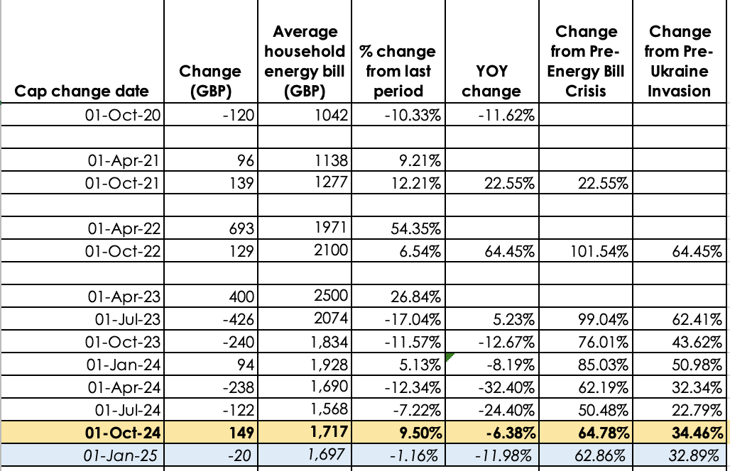
Energy prices continue to stay high
Unit cost changes available at
https://www.endfuelpoverty.org.uk/about-fuel-poverty/ofgem-price-cap/
Figures in italics based on Cornwall Insight latest predictions.
Even if Russian gas came back onto the market, prices today would be 31% higher than in winter 2020/21
Notes:
Unit prices… Average HH bill
Record numbers in fuel poverty

Slide 4
Likely priorities for 2025
Social tariff
Definition of fuel poverty
Making the case for investment in tackling fuel poverty to Treasury
Links between investment and bill reduction
Economic benefits of investment, including jobs
Providing confidence in deliverability at scale
Protecting vulnerable households
Older people / winter fuel payment
Disabled people / excess costs of disability
Long term health concerns linked to poor housing
Left behind by smart meters / digital tech / RTS
Sustainable end to fuel poverty and attacks from the far right on solutions

Slide 5
Insulation
Cold Damp homes
Energy firm profits tally
Role of market trading in energy prices
Ongoing profits announcements
Price Cap (22 Nov / 1 Jan)
Price Cap (c. 25 Feb / 1 Apr)
Energy Independence Bill
Select Committee Inquiries
New MPs outreach
Notes:
End Fuel Poverty Coalition members - as well as significant players on a national, regional and now local level. Other campaign partners include:
Uplift
Green Alliance
Oxfam
The Climate Coalition
Wildlife Trusts
WWF-UK
New Economics Foundation
Global Action Plan
UKGBC
38 Degrees
Hope for the Future
Climate Cymru
RSPB
Operation Noah
Islamic Relief
Global Witness
Citizens UK

Slide 6
LinkedIn, X, Blue Sky, Threads & Mastodon @EndFuelPoverty
Questions, comments and requests to sign up / join to
simon.francis@
campaigncollective.org
twitter.com/ThisWinterUK
facebook.com/WarmThisWinter
instagram.com/warmthiswinteruk
To sign up email caroline@upliftuk.org

