Slide 1


Addressing Inequality and Injustice
  Stephen Sinclair
  Chair, Poverty & Inequality Commission
  Energy Action Scotland Annual Conference
  15th November 2024

Slide 2

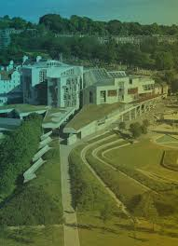
Poverty & Inequality Commission
  Non Departmental Public Body – statutory since 2019
  9 members – assumed office July 2024
  Experience Panel
  Three roles:
  Advice
  Accountability
  Advocacy
  Some recent outputs:
  Child Poverty Scrutiny report (June 2024)
  Intersectionality Strategy (Dec. 2023)
  How Better Tax Policy Can Reduce Poverty and Inequality: Recommendations for an Effective and Accountable Scotland (Oct. 2023)
Today expressing personal views rather than Commission policy

Slide 3
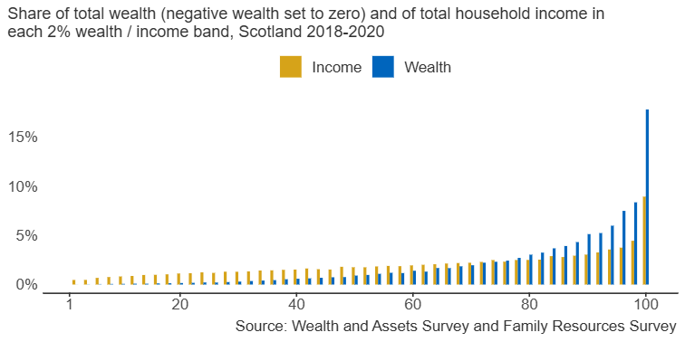
Wealth and Income Inequality in Scotland
Income and Wealth Distribution in Scotland

Slide 4
Which Inequalities are Unjust?
  ‘Social (in)justice’ is an essentially contested concept
  Unequal outcomes may be considered unjust if they are either –
  Unjustifiable - violate an important principle
  Unjustified - unmerited
  Poverty is an injustice = income below threshold required for minimum standard of decency

Slide 5
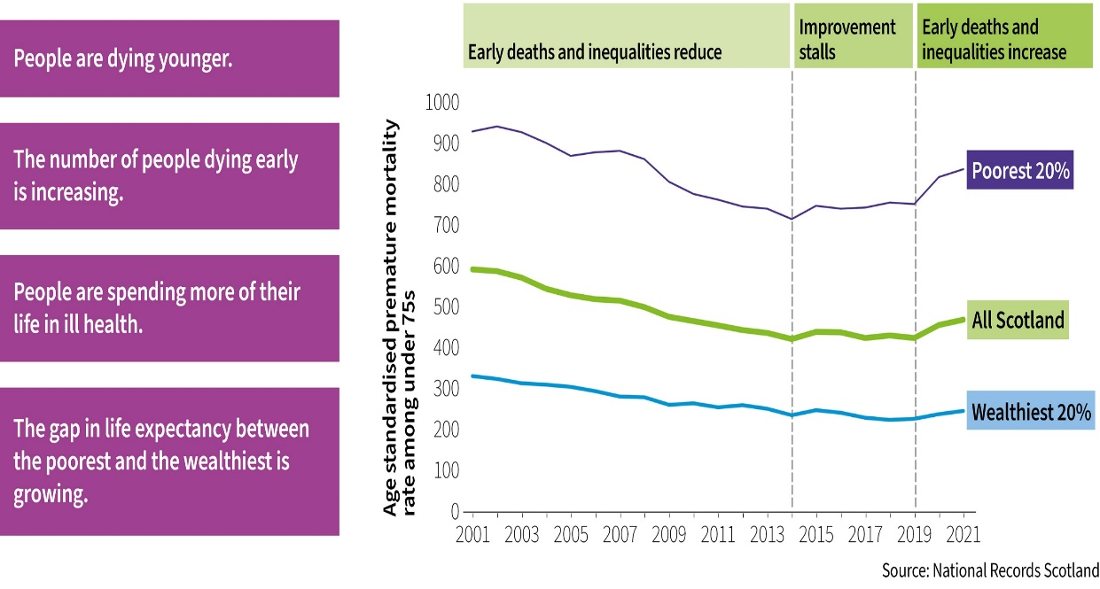
Unfair and Unjust Inequalities: Health
Developments in Health Inequality in Scotland, 2001-2021

Slide 6
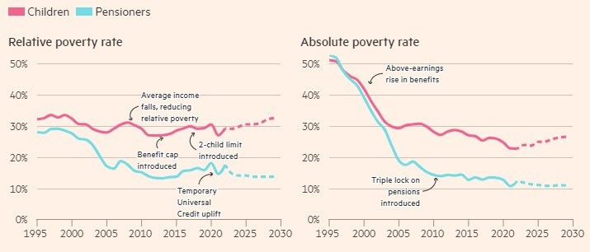
Policies Can Make Difference 1
UK Poverty Trends, 1995-2030
Source: Financial Times

Slide 7
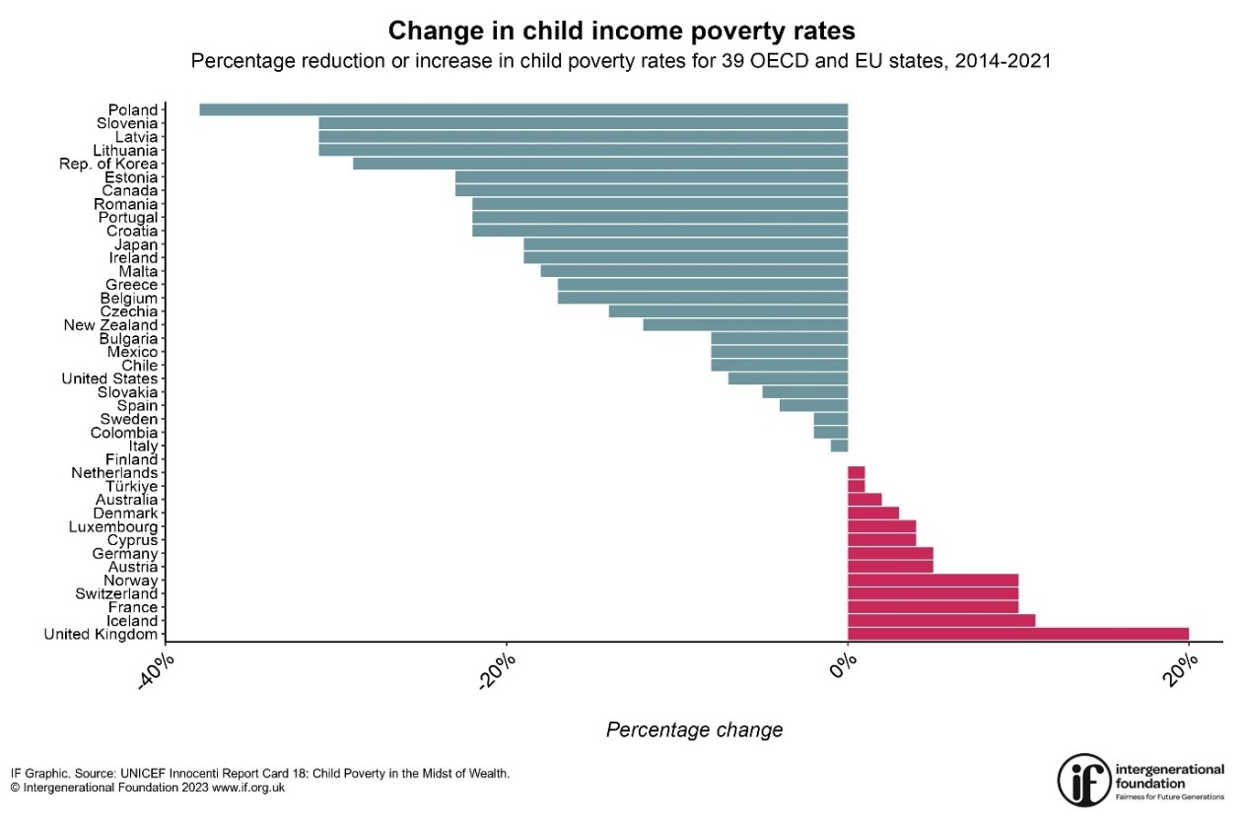
Policies Can Make Difference 2

Slide 8
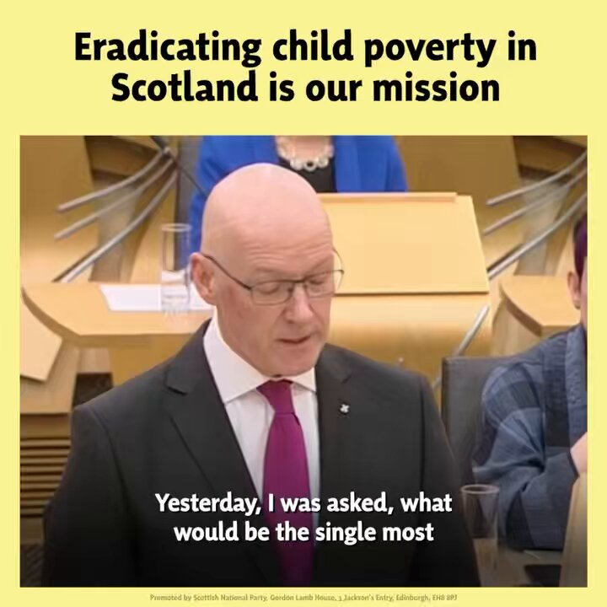
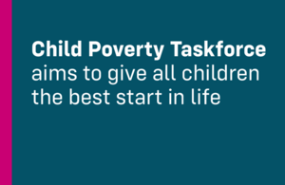
Commitment to Improve Outcomes
  John Swinney, First Minister:
  ‘I was asked by one journalist what would be the key policy objective I would want to achieve as First Minister. I said I wanted to do all that I could to eradicate child poverty. I believe it to be a curse in a 21st Century, advanced Western society that children are brought up in an environment of poverty’
Liz Kendall, UK Work and Pensions Secretary:
‘It is unacceptable that more than 4 million children are now growing up in poverty. Under our new government, this will change’

Slide 9
Actions to Improve Outcomes
  Two actions required:
  1. Focus resources on greatest need: progressive universalism
  2. A floor below which no one will fall: Minimum Income Guarantee
  Winter Fuel Payment / Pension Age Winter Heating Payment controversy
  Poverty rates, Scotland 2022/23:
  Children – 24%
  Working age people - 21%
  Pensioners - 15%

Slide 10
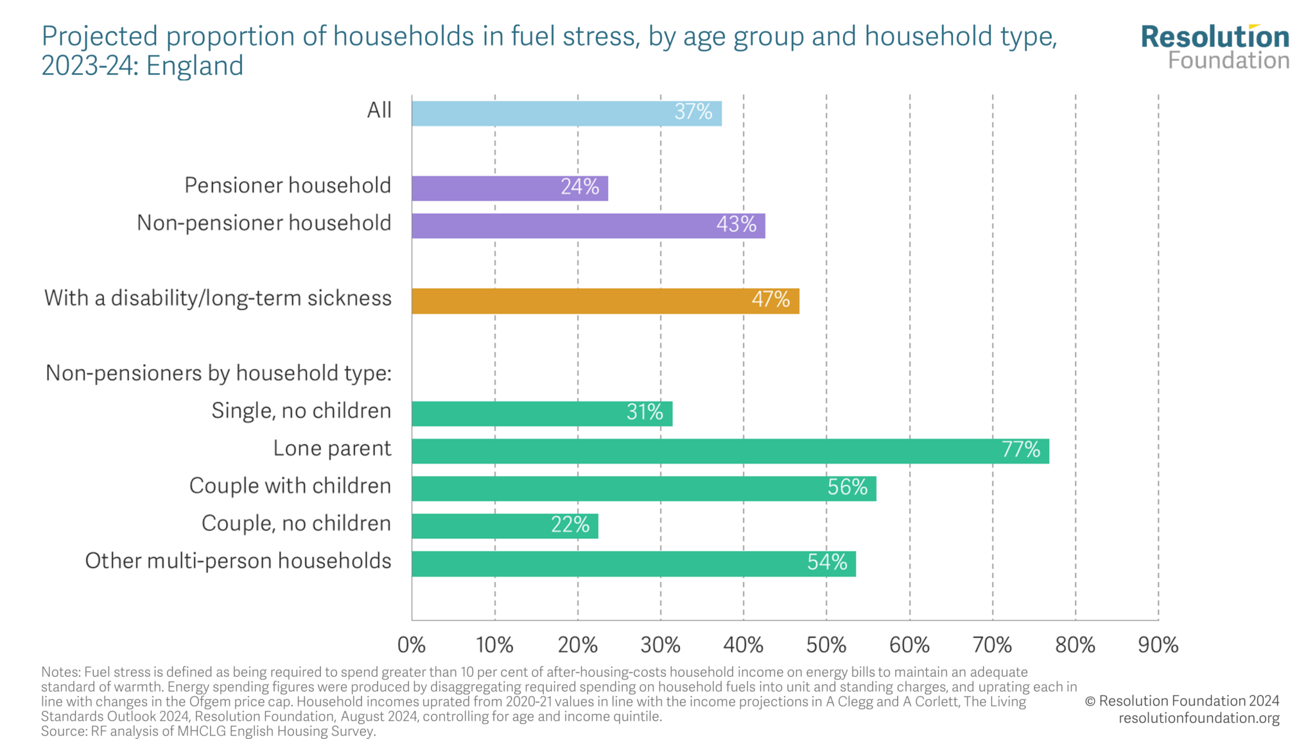
Focusing Resources

Slide 11
Minimum Income Guarantee
  UN Special Rapporteur on Extreme Poverty and Human Rights:
  ‘Effective strategies to tackle child poverty … need to combine universal policies with additional policies targeted at children and households in vulnerable situations. As we have seen, this is referred to as “progressive” or “ tailored" universalism’ (De Schutter, 2023: 140)
Social citizenship:
‘The right to a modicum of economic welfare and security to the right to share to the full in the social heritage and to live the life of a civilised being according to the standards prevailing in society’ (Marshall, 1948)
  Lansley: guaranteed income floor as a citizenship right creates a ‘Plimsoll line’ below which no one would fall
  Minimum Income Guarantee Working Group report to be published soon
  Cabinet Secretary for Social Justice: MIG is an ‘innovative and bold’ initiative
  When the status quo isn’t working innovation is necessary

Slide 12
  Thank you for listening
  https://povertyinequality.scot/
  Contact: info@povertyinequality.scot

